Slide 1
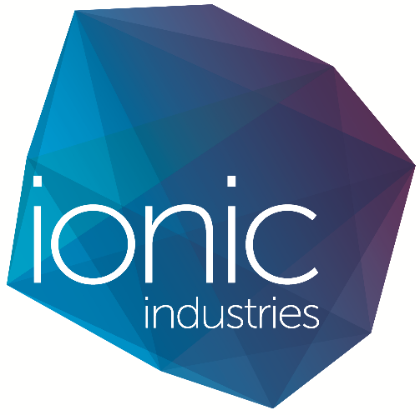
Annual General Meeting - Update Report
November 2018

Slide 2
Disclaimer
Certain statements contained in this presentation, including information as to the future financial or operating performance of Ionic Industries Ltd (“Ionic”) and its projects, are forward looking statements. Such forward looking statements:
include, among other things, statements regarding incomplete and uncertain proposals or targets, production and prices, operating costs and results, capital expenditures, and are or may be based on assumptions and estimates related to future technical, economic, market, political, social and other conditions;
are necessarily based upon a number of estimates and assumptions that, while considered reasonable by Ionic, are inherently subject to significant technical, business, economic, competitive, political and social uncertainties and contingencies; and
involve known and unknown risks and uncertainties that could cause actual events or results to differ materially from estimated or anticipated events or results reflected in such forward looking statements.
Ionic disclaims any intent or obligation to update publicly any forward looking statements, whether as a result of new information, future events or results or otherwise. The words “believe”, “expect”, “anticipate”, “indicate”, “contemplate”, “target”, “plan”, “intends”, “continue”, “budget”, “estimate”, “may”, “will”, “schedule” and similar expressions identify forward looking statements.
All forward looking statements made in this presentation are qualified by the foregoing cautionary statements. Recipients are cautioned that forward looking statements are not guarantees of future performance and accordingly investors are cautioned not to put undue reliance on forward looking statements due to the inherent uncertainty therein

Slide 3
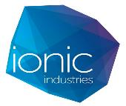
Current Strategy
Our strategy remains the same, which involves the formation of strategic partnerships with industry leading companies who have the expertise to incorporate our graphene-based technologies into commercial products.
Early stage research and identification of potential applications
Technology validation, application feasibility and product development
Product deployment with commercialisation partners or marketing and sales
Ionic with Commercialisation Partners
Joint Venture Company
Licenced technology
Revenues
Building on our partnerships and technology over 7 years and $3.4 million in R&D funding, Ionic is now one of the first companies to demonstrate large scale, commercially viable application of graphene technologies
Collaboration model reduces technology validation risks and accelerates paths to market, thereby reducing uncertainty and business risks
Portfolio approach to technologies and applications mitigates the risk of reliance on a single technology and expands market potential

Slide 4
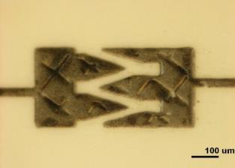
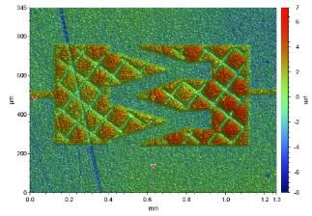
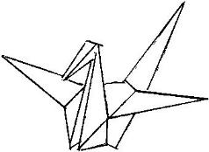
Research Progress
Over the past year we have made a number of important advances on our graphene research programs:
Work on the water treatment technologies has continued successfully and CleanTeQ exercised their option to form a venture to commercialise the technology
We have worked on developing a prototype supercapacitor device for use in IoT applications. We delivered sample devices to Nanothings Inc in the USA in November 2018
We have signed an MOU with Nanothings Inc, who are an IoT technology company with backing from some of the largest corporations involved in IoT technologies in the USA
Work has continued on our MICRENs devices and we can now print these consistently at about 50 micron, which is at the scale we need to benefit from the “edge effects” that will enable supercapacitors that rival Li-ion batteries
Our patents have progressed including:
Final award of our micro supercapacitor patent
Final national phase for our membranes patent.
Ongoing refinement of our MICRENs printing patent and Green Graphene patent
2 additional patents for filing in the immediate future.

Slide 5
CleanTeQ AGM Addresses Ionic JV

Slide 6
Nanothings Inc MOU
Ionic has signed an MOU with Nanothings Inc with the following objective:
There is a rapidly growing global demand for IoT technologies. Nanothings and Ionic have valuable intellectual property, relationships and manufacturing capabilities relevant to IoT technologies and the objective of the collaboration is to develop an energy storage solution that will enable a new generation of IoT tracking technologies based on Nanothings’ proprietary NanoTag devices.
Nanothings has proprietary technology for IoT applications, including printed circuitry and sensor tags, firmware, and software that enable disposable, long range, low cost applications in numerous industries.
To progress this technology, Nanothings requires an energy storage solution that is not currently available in the open market.
Nanothings also has significant market access for its technologies through relationships with major IoT companies including Semtech, Sigfox, Senet, M2Comm and MachineQ.

Slide 7
MICRENs Supercapacitor Printing
Our patent pending, rapid printing process for manufacturing MICRENS will contribute to scalability and cost advantages
Target applications:
On-chip capacitors (µF-mF range) with variable voltage
Implantable medical devices
Wearables
IoT devices
Quantum capacitors

Slide 8
Critical Relationships
Ionic’s partnerships remain at the centre of our strategy and the value we are creating:
Clean TeQ has gone from strength to strength and we are in the process of standing-up our venture, to be operational early 2019
Our relationship with Nanothings is evolving rapidly and we aim to exploit this for commercialisation of our supercapacitor technologies in the near term
Monash University – our relationship remains strong and we continue to be engaged across multiple faculties, supporting Monash objectives and further deepening our ties
Expanding University engagement with other researchers at Melbourne and Deakin Universities, including the award of the ARC Industry Transformation Training Centre for Future Energy Storage Technologies
Ionic has been heavily engaged in the formation of the Australian Graphene Industry Association, driving collaboration in the graphene industry in Australia and internationally

Slide 9
Over The Horizon
As a technology platform, Ionic will build on existing experience and expertise to deliver a stream of advanced materials technologies to market over the coming years. Promising applications where we may have some advantage include:
Gas separation using nano-filtration membranes
Graphene oxide barrier coatings
Graphene oxide industrial additives
MICRENs sensor technologies
Anti-corrosion coatings
Bulk materials manufacturing

Slide 10
Next Steps
We are planning a range of initiatives and milestones over the next 12 months to progress our strategy.
Stand-up our venture with CleanTeQ, capitalise it and build out its operational capability
Deliver fully-functioning prototype devices to Nanothings Inc and begin commercial discussions, including manufacturing arrangements
Develop plans for broader marketing of Origami Capacitor technology to address IoT applications
Move to next phase of MICRENs development and begin work on purpose specific MICREN product in collaboration with an industry partner in one of our target markets
We may need to seek further capital which could come in several forms:
Strategic investors
Listing on the ASX

Slide 11
Thank You
Simon Savage
Managing Director
simons@ionicindustries.com.au
+61 402 388 702

